Slide 1
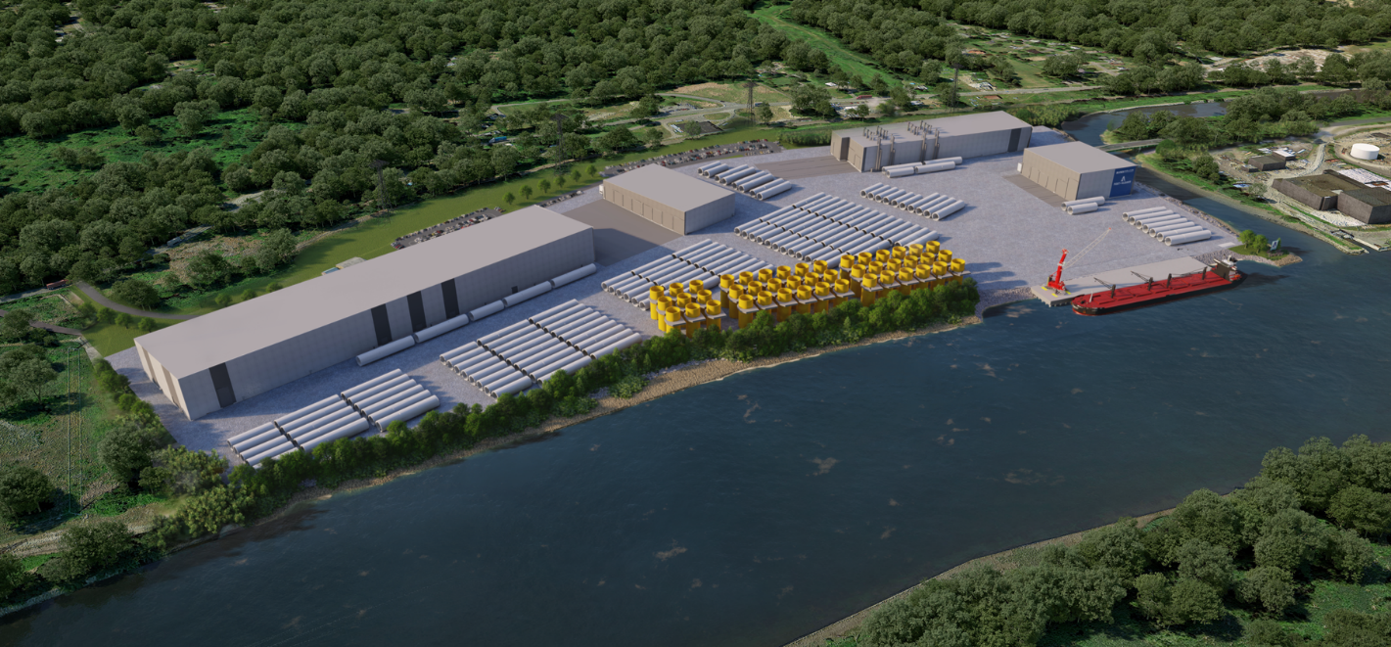
Port of Albany Marmen-Welcon Tower Manufacturing Plant
Town ZBA Public Hearing
March 16, 2022
Notes:
Introduce Team depending on who is present

Slide 2
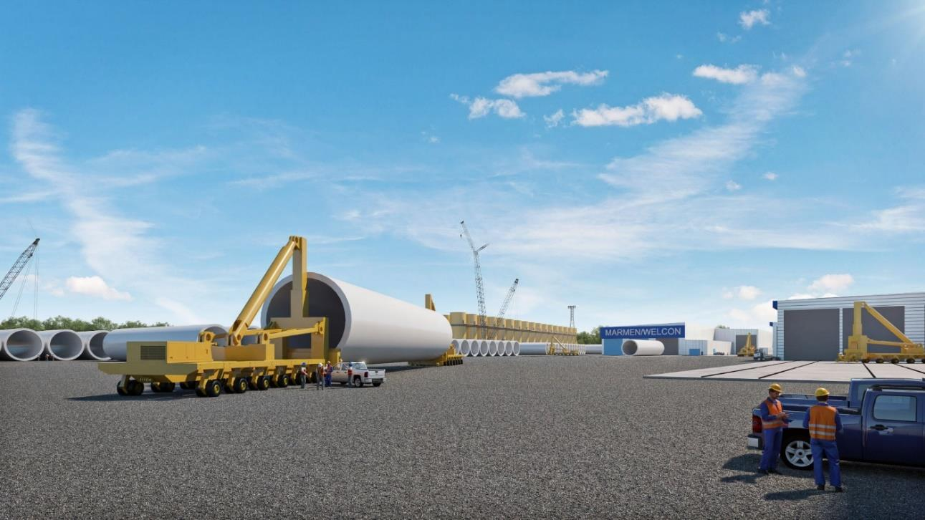
Port of Albany | Timeline
2018 Property acquisition
2018-2020 Due diligence performed and State environmental permitting process regarding potential project took place with Town Planning Board
2021 New York State and the NYS Energy Research and Development Authority announce Offshore Wind project at the Port of Albany
2021 Site Plan permitting
2022 – 2023 Construction
2024 Full operation
2023-2026 Marmen hiring
Notes:
This project has been in the works for a while:
The Port Acquired the property in 2018
Generic EIS was reviewed and approved in 2019 by the Town Planning Board
2021 State Announced Off-shore wind project at the Port of Albany
Supplemental EIS is completed with the Town Planning Board approval for the Finding State yesterday
Full Operation is required in 2024 to meet State’s Off-shore Wind Mandates

Slide 3
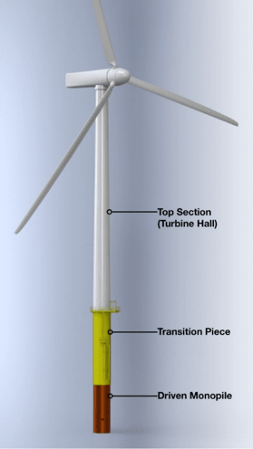
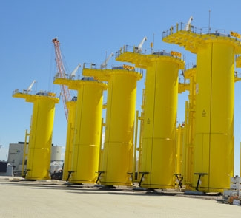
Project Overview
Production of Towers & Transition Pieces
Notes:
Background on Off-shore wind turbines:
Turbine, blades, Towers, Transition Pieces and Foundations
Facility will manufacture the White Tower Section and the Yellow Transition Pieces

Slide 4
Project Overview
Port of Albany as Owner in association with Marmen, Quebec, Canada + Welcon, Denmark, as operator.
Manufacturing space throughout 5 separate buildings, utility services, and stormwater management facilities
Tower production will occur within 4 buildings (buildings A-D) located on the Port Expansion property in the Town of Bethlehem. The 5th building (building E) is located at 700 Smith Boulevard within the existing Port District in the City of Albany.
All raw materials (truck, rail, vessel) will be received at 700 Smith Boulevard and transported by Marmen-Welcon owned trucks on internal Port roads only along Normanskill Road to the production site.
All employees and visitors will access the facility via the River Road driveway and enter through a secure turnstile gate. The Normanskill Bridge is for Marmen-Welcon truck deliveries only.
Total investment is estimated to be $450 million and 55o new permanent jobs
Notes:
Back in 2021 the Marmen-Welcon Team was awarded the project form the State
Read the bullets

Slide 5
Project Overview
Submitted Application Materials to Town:
Site Plan Sets (Beacon Island & 700 Smith Blvd.) - 68 drawings
Normanskill Street Rehabilitation Plan - 17 drawings
Offsite Roadway & Utility Plan - 8 drawings
SEQRA Compliance Document - 18 pages
Supplemental EIS - 1,460 pages
Joint Permit Application - 1,086 pages
Part 182 Application - 396 pages
2019 Final Generic EIS (FGEIS) - 3,600 pages
626,000 square foot Off-Shore Wind Tower Manufacturing Plant. Go to portofalbany.us for more details:
https://www.portofalbany.us/public-records/public-documents/
Notes:
An massive amount of material and documents have been reviewed by the Town Planning Board over the last 3-4 years listed here
The documents and additional detail can be found on the Port of Albany Website

Slide 6
Project Overview
Surface parking lot on 4.5 acre adjoining property
Proposed Bridge over Normans Kill
Normanskill Street Improvements
Existing low level fixed bridges
Normans Kill
Hudson River
New Wharf and Dredging
(+/- 500 linear feet)
Offsite Building at
700 Smith Blvd (14 acres)
Main Site Development (81.6 acres)
(+/- 604,000 SF of warehouse buildings)
Project Location / Project Site
Notes:
All Raw Material Delivered to 700 Smith Blvd via Rail, Vessel and Truck
Stored at 700 Smith Blvd for on-time delivery to the manufacturing site at Beacon Island by Marmen owned trucks
Transportation to Beacon Island is via Normanskill Street which will be rehabilitated as part of the project and over a new vehicular bridge to Beacon Island being constructed as part of this project

Slide 7
Project Overview
+/- 626,000 square feet (SF) of Manufacturing space throughout 5 separate buildings, utility services, and stormwater management facilities
The following is a breakdown of the function and size of each building modified for Transition Piece manufacturing:
Building A Plate Preparation & Welding (299,414 s.f.)
Building B Welding Finishing (111,189 s.f.)
Building C Blast Metallization Plant (132,014 s.f.)
Building D Internal Assembly finishing (61,647 s.f.)
Building E Material Receiving & Staging Yard (21,748 s.f.)
Parking area with 360 spaces
Notes:
Total of 626,000 SF of new building space between the five proposed buildings
360 new parking spaces at the Beacon Island Manufacturing Site

Slide 8
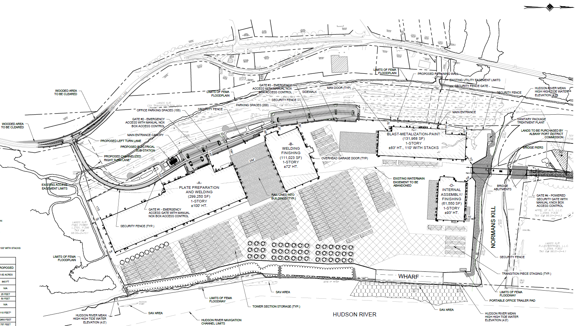
Tower & TP Production Facility Site Plan
Notes:
Fabrication to occur in a counterclockwise direction from building A to Building D
Employee/Visitor Access via River Road (NYS Route 144)
Deliver truck access via bridge over Normans Kill
New 500’ Wharf on the Hudson River for deliver of finished products
Product to be staged in a gravel yard area
360 new employee parking spaces partially on National Grid Property
Existing Vegetation to Remain along Hudson River

Slide 9
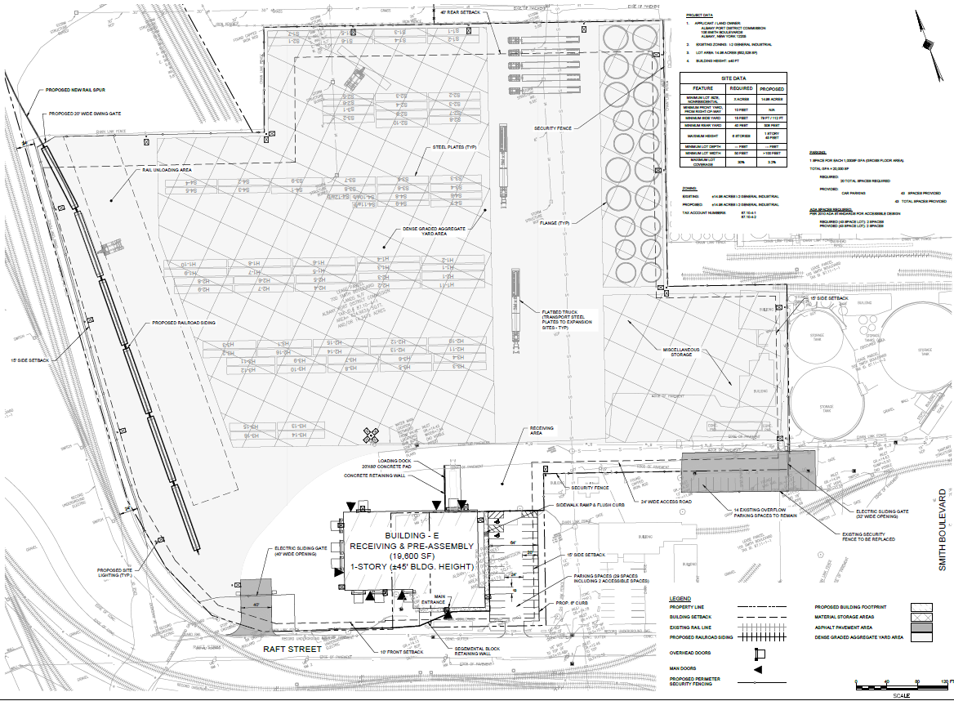
Receiving & Staging Facility: 700 Smith Blvd - City of Albany
Notes:
700 Smith Blvd Deliver site within the City of Albany, point out the new rail spur

Slide 10
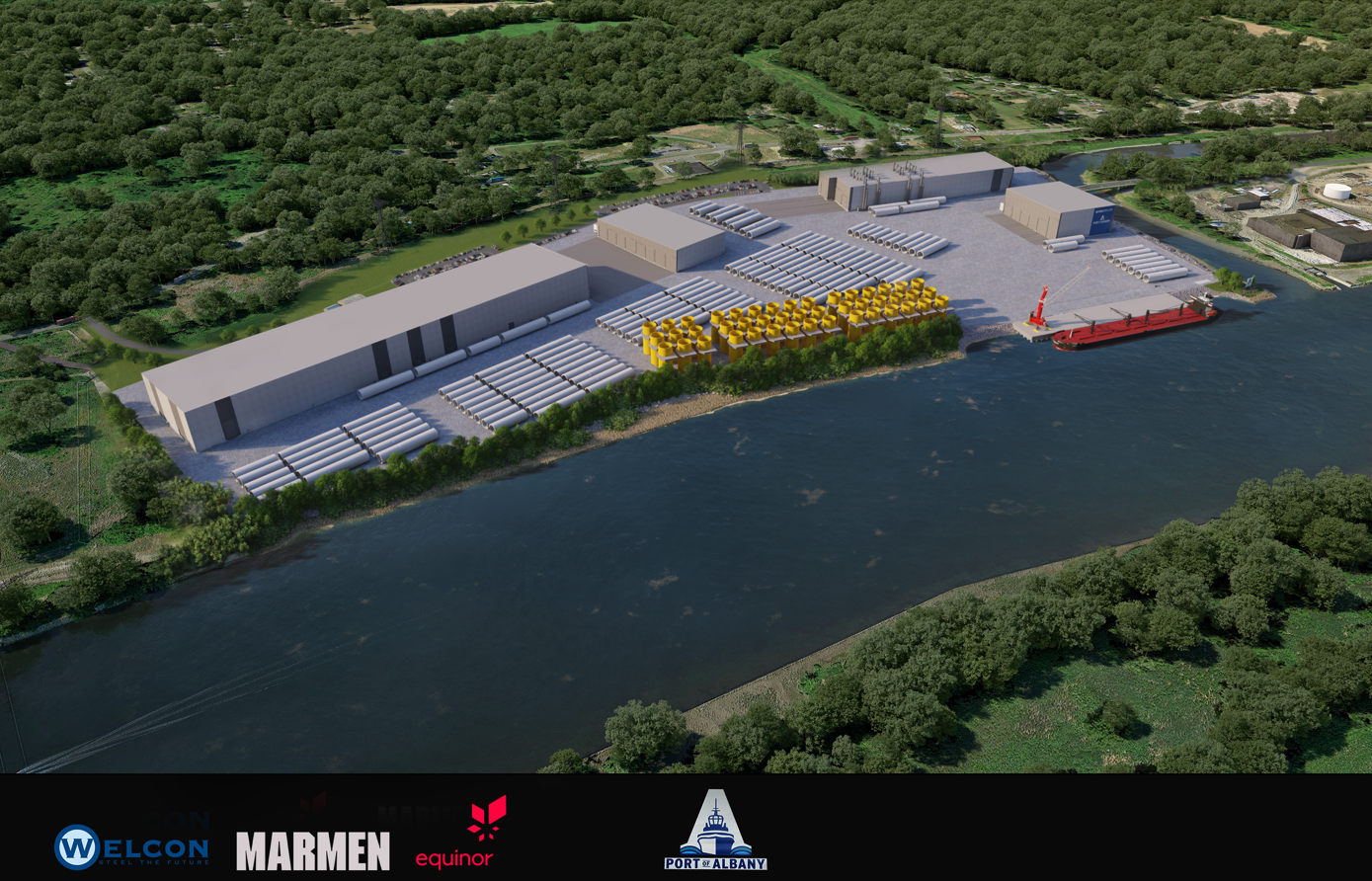
Notes:
3D Simulation of the proposed Site

Slide 11
Project Zoning Code Variance Requests
Development within the Normans Kill 100-year Floodplain
Front Setback Less Than 100’
Less than 10% Landscaping within the Parking Area
Building Heights Greater Than 60’:
Building A Plate Preparation & Welding – 100’
Building B Welding Finishing – 72’
Building C Blast Metallization Plant – 83’ (110’ including exhaust stacks)
Building D Internal Assembly finishing – 93’

Slide 12
Supplemental Final Environmental Impact Statement Final Finding SEQRA Statement Approval 3/15/22
Below are the relavant updates from what was previously studied in the FGEIS and updated in the FSEIS to reflect the proposed development:
Updated Site Plans
National Grid Property Utilization
626,000 SF Buildings
390 total Parking Spaces
Air Impact Analysis per NYSDEC DAR-1 and DAR-10 guidance
No impact to the surrounding community
Traffic Impact Study
Less peak hour traffic than studied in the FGEIS
No additional impacts from that stated in the FGEIS
All deliveries to 700 Smith Boulevard within the existing Port District
Visual Impact Assessment
GEIS approved maximum building Height of 85’
FEIS increased maximum building height from 85 feet to 110 feet
Drainage Report & Design
Reduced imperviousness by preserving existing Hudson River shoreline
Using BMP within National Grid property
Soil Management Plan
All existing soil to remain on the property
Notes:
GEIS Approved for 85’ high buildings
FEIS has been approved which included a visual impact assessment which was provided as part of the variance application
VIA was reviewed by the Town Planning Board (lead agent) and various state agencies
Maintaining Hudson River vegetation and modifications to storage locations in response to EIS comments

Slide 13
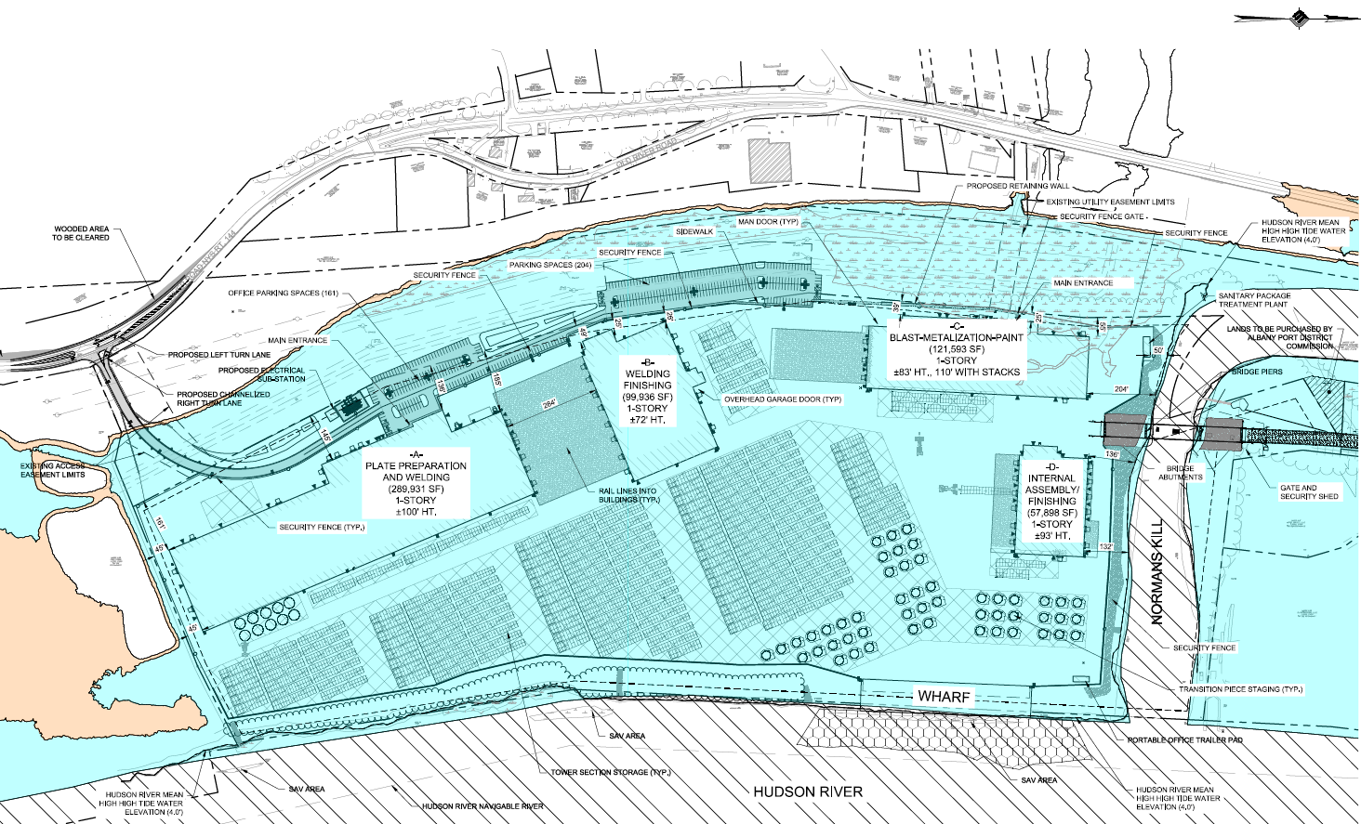
Development within Normans Kill 100-year Floodplain
Notes:
The whole site is within the 100-year floodplain
Site will be raised up to allow the building FFE to be at 21.0’ – 3’ above the Flood Plan Elevation of 18.0’
Access the to Hudson River is required for the project and thus development within the 100-year Floodplain is unavoidable

Slide 14
Development within Normans Kill 100-year Floodplain
No change in character of the Neighborhood as the Floodplain has existing industrial development to the North (Port District) and the South (PSEG Power Plant.
The entire site is within the 100-year Floodplain, therefore the only alternative would be a different site. This site was selected by the State of New York for development of Off-shore Wind Development.
The development will raise the site to allow the building finished floor elevation to be at elevation 21.0’, which is 3’ above the current 100-year floodplain elevation.
The development will protect the Normans Kill shoreline from erosion with stone fill and live stakes while 1700’ of the Hudson shoreline will contain a vegetation buffer to the project to minimize the impacts of the development.
This site was a pre-selected site for off-shore wind manufacturing; therefore, this variance was not self-created by the applicant.
Notes:
The whole site is within the 100-year floodplain
Site will be raised up to allow the building FFE to be at 21.0’ – 3’ above the Flood Plan Elevation of 18.0’
Access the to Hudson River is required for the project and thus development within the 100-year Floodplain is unavoidable

Slide 15
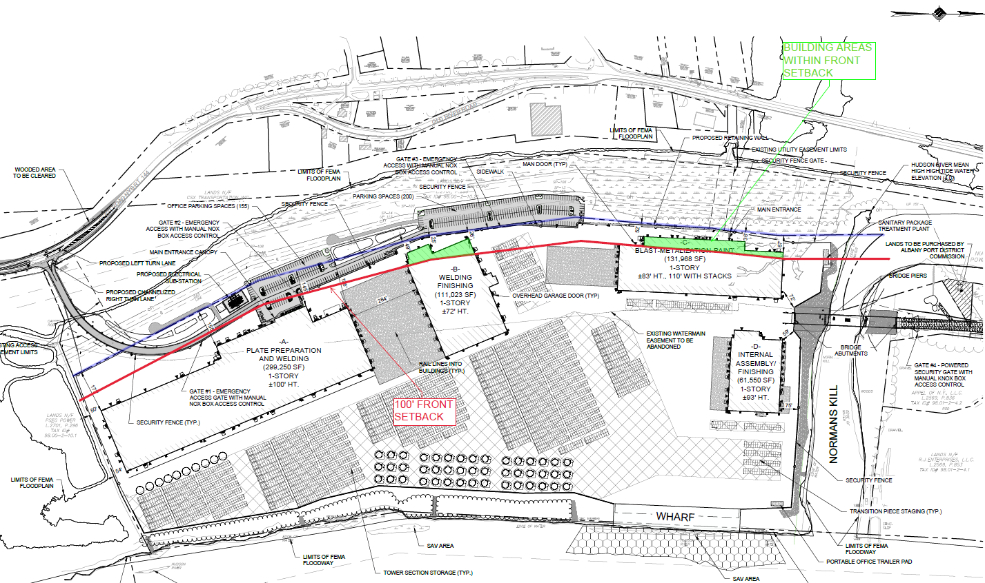
Front Setback Variance – 25’ Provided vs 100’ Required
Notes:
We maintained the required Side setback of 25’ given that the adjacent property is owned by National Grid and not a Public ROW.
Additional Land to the west is needed from National Grid to provide adequate property, buildings within the 100’ front setback is unavoidable.

Slide 16
Front Setback Variance – 25’ Provided vs 100’ Required
No change in character of the Neighborhood as the setback is to the existing National Grid utility corridor and includes development easement onto their property to accommodate the project. The setback is not to a public ROW.
The entire site is being utilized to accommodate the production requirements for the fabrication, staging and storage of the Tower and Transition Pieces. Given the site’s unique orientation and location on the Hudson River and Normans Kill there are no other alternatives.
The proposed variance is not substantial since the building will meet the code required side setback from the property line (25’).
No adverse environmental impacts are anticipated as the development’s site plan has gone through the GEIS and SEIS SEQRA processes and the SEQRA finding statement has been approved by the lead agency.
This site was a pre-selected site by the State of New York for off-shore wind manufacturing and the entire site is being utilized; therefore, this variance was not self-created by the applicant.
Notes:
We maintained the required Side setback of 25’ given that the adjacent property is owned by National Grid and not a Public ROW.
Additional Land to the west is needed from National Grid to provide adequate property, buildings within the 100’ front setback is unavoidable.

Slide 17
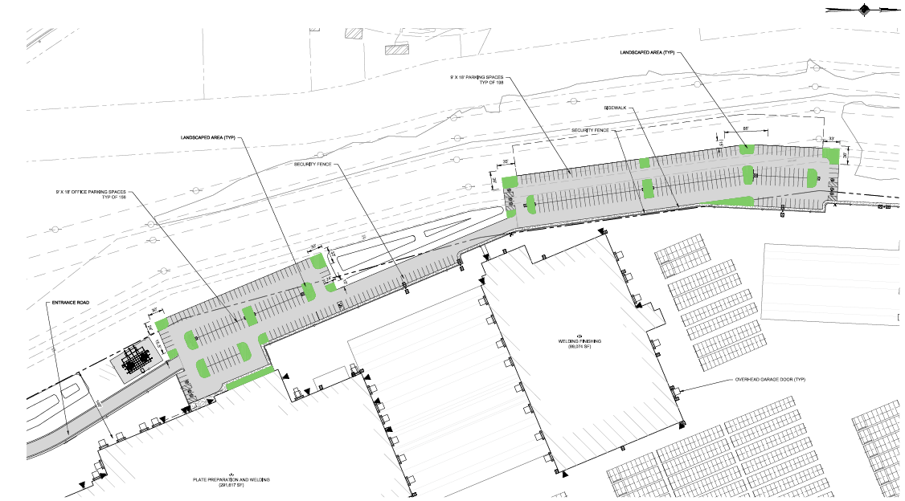
Landscaping Area – 8.2% Provided vs 10% Required
Notes:
Town code requires 10% landscaping coverage within the Parking Lot
8.2% is provided with additional landscaping outside the “Parking Area” at the front entrance and around the detention plans, but not counted towards the requirement.
360 parking spaces are provided which is the minimum allowed for the facility.
Any additional parking lot expansion to accommodate landscaping would require further encroachment onto National Grid Property.

Slide 18
Landscaping Area – 8.2% Provided vs 10% Required
There is no change in character of the neighborhood since little to no parking lot landscaping I spresent within the Port District immediately to the north, the PSEG plant to the south or the National Grid property to the West.
The parking areas include the minimal number of required parking spaces for the facility. Any additional parking lot expansion to accommodate landscaping would require further encroachment onto National Grid Property.
The 8.2% of parking lot landscaping is provided within the parking field; however additional building foundation landscaping and landscaping around the ponds will also be provided as part of the project as mitigation for this variance.
No adverse environmental impacts are anticipated as the development’s site plan including landscaping has gone through the GEIS and SEIS SEQRA processes and the SEQRA finding statement has been approved by the lead agency.
This site was a pre-selected site for off-shore wind manufacturing and the entire site is being utilized; therefore, this variance was not self-created by the applicant.
Notes:
Town code requires 10% landscaping coverage within the Parking Lot
8.2% is provided with additional landscaping outside the “Parking Area” at the front entrance and around the detention plans, but not counted towards the requirement.
360 parking spaces are provided which is the minimum allowed for the facility.
Any additional parking lot expansion to accommodate landscaping would require further encroachment onto National Grid Property.

Slide 19
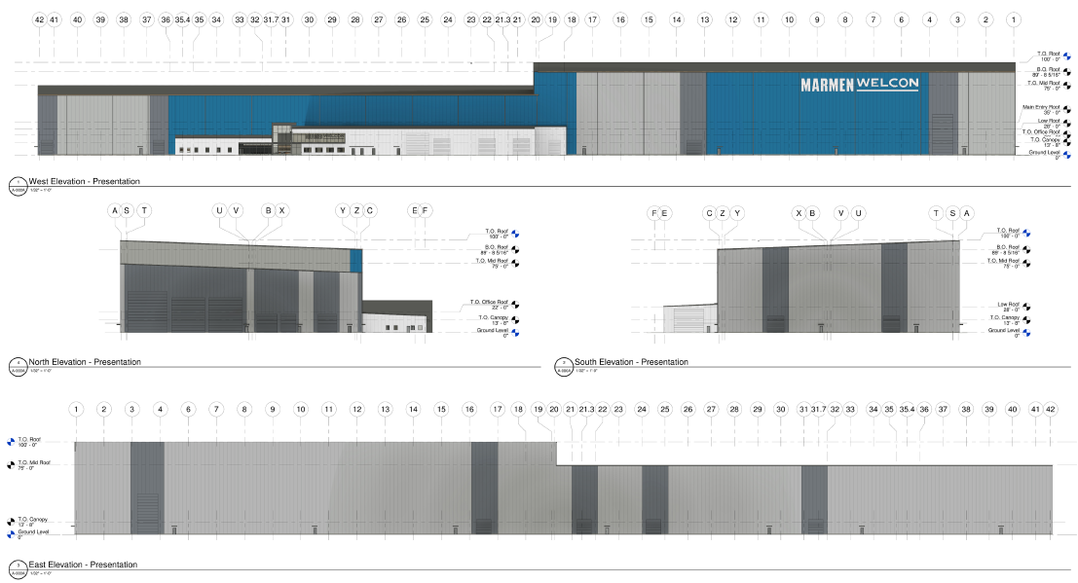
Building A – Elevations (100’ Max)

Slide 20
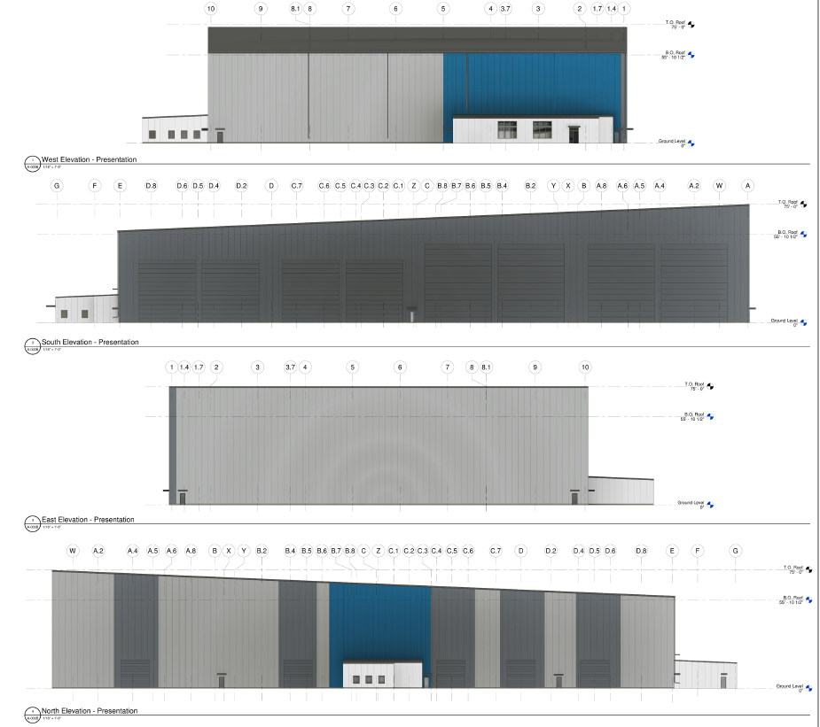
Building B – Elevations (72’ Max)

Slide 21
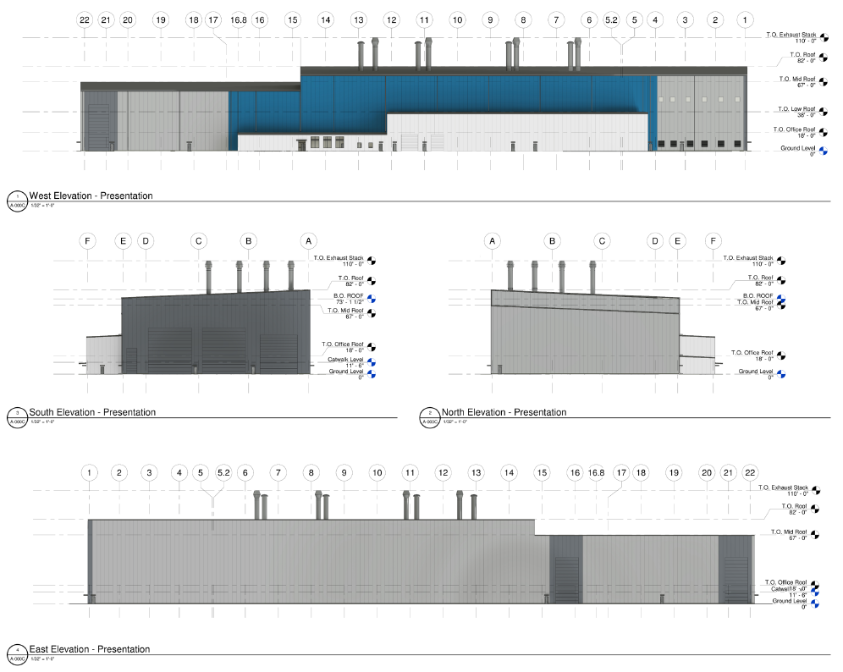
Building C – Elevations (83’ Bldg, 110’ Stacks Max)

Slide 22
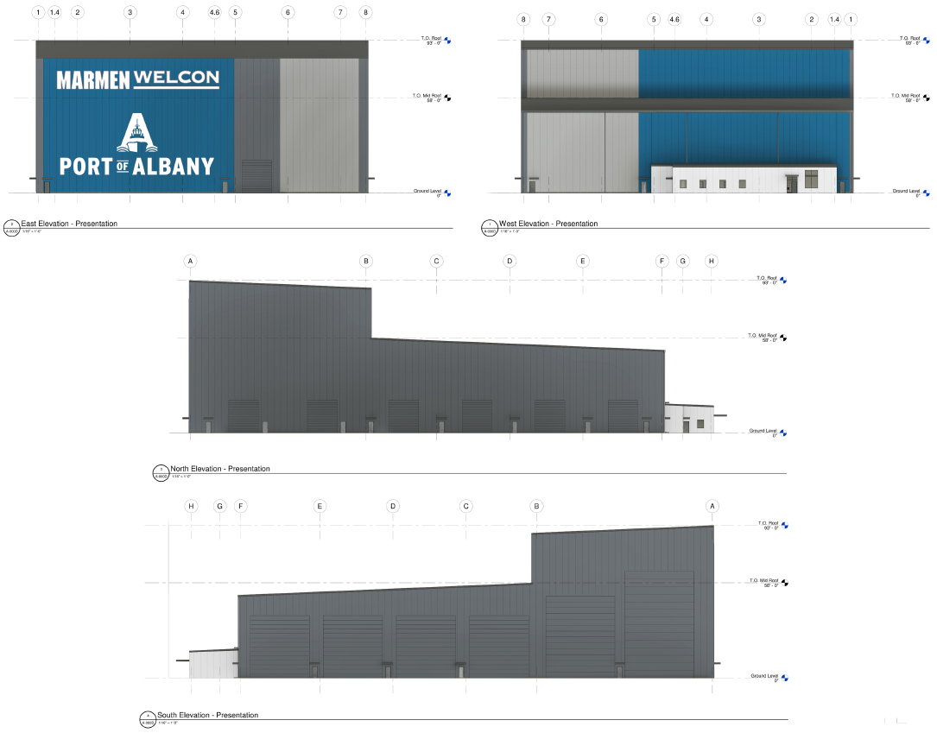
Building D – Elevations (93’ Max)

Slide 23
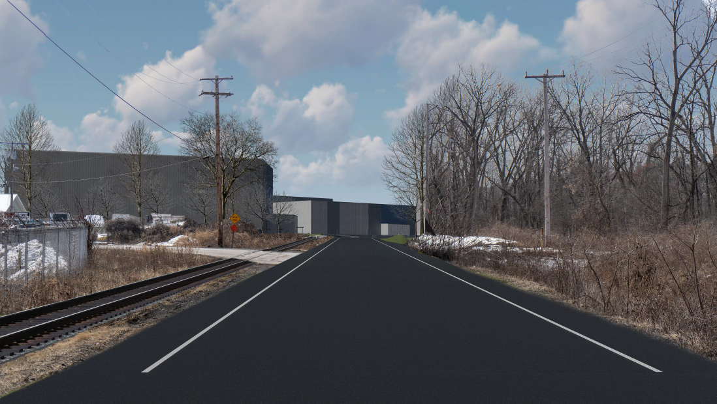
Photo Simulations
Location 1: at the end of Normanskill Street looking south into the site.

Slide 24
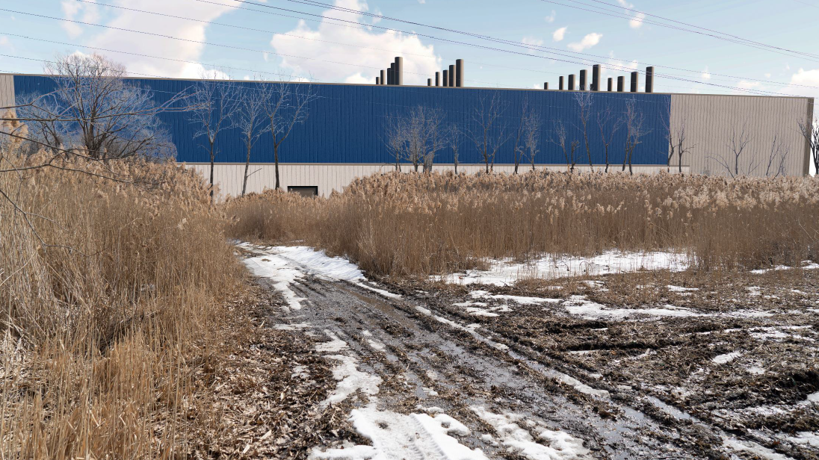
Photo Simulations
Location 2: at northwest property line of the project looking east into the site.

Slide 25
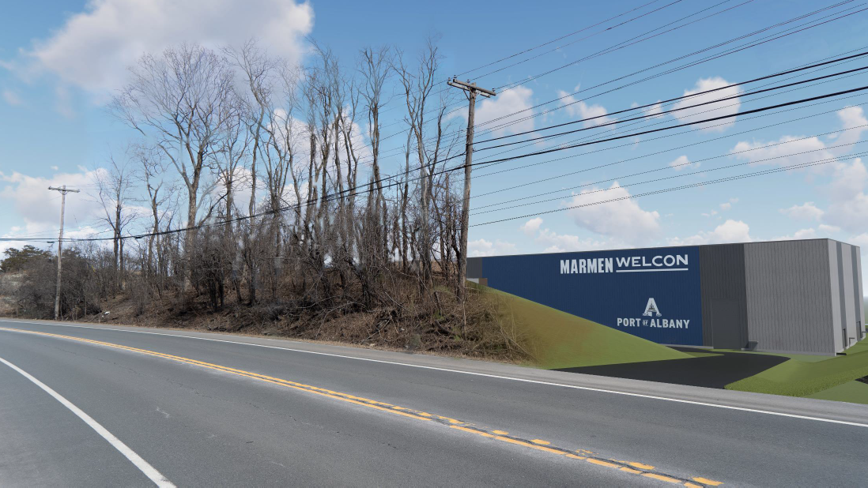
Photo Simulations
Location 3: on NYS Route 144 at the proposed southwest entrance to the project looking east into the project site.

Slide 26
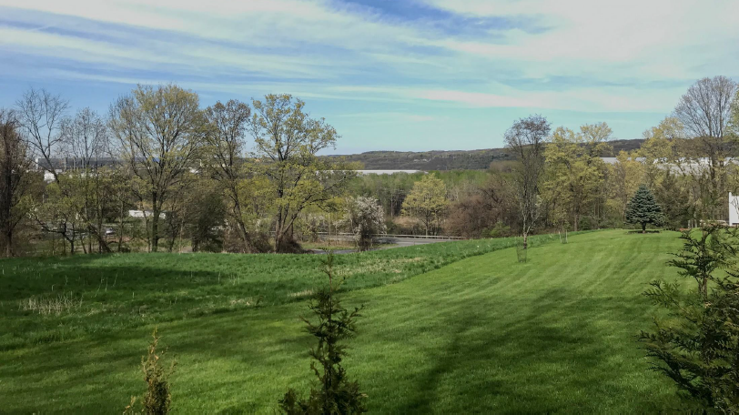
Photo Simulations
Location 4: on Glenmont Road at the location of cleared vegetation allowing a view of the Hudson valley looking east toward the project.

Slide 27
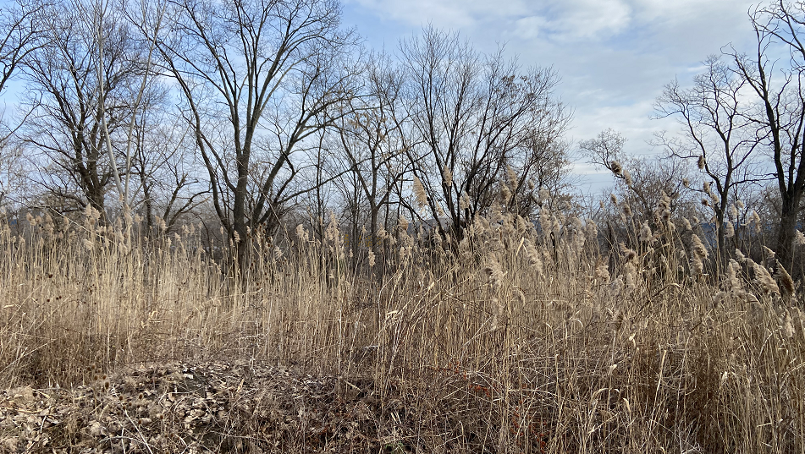
Photo Simulations
Location 6: on 23 Old River Road looking east into the project site (winter).

Slide 28
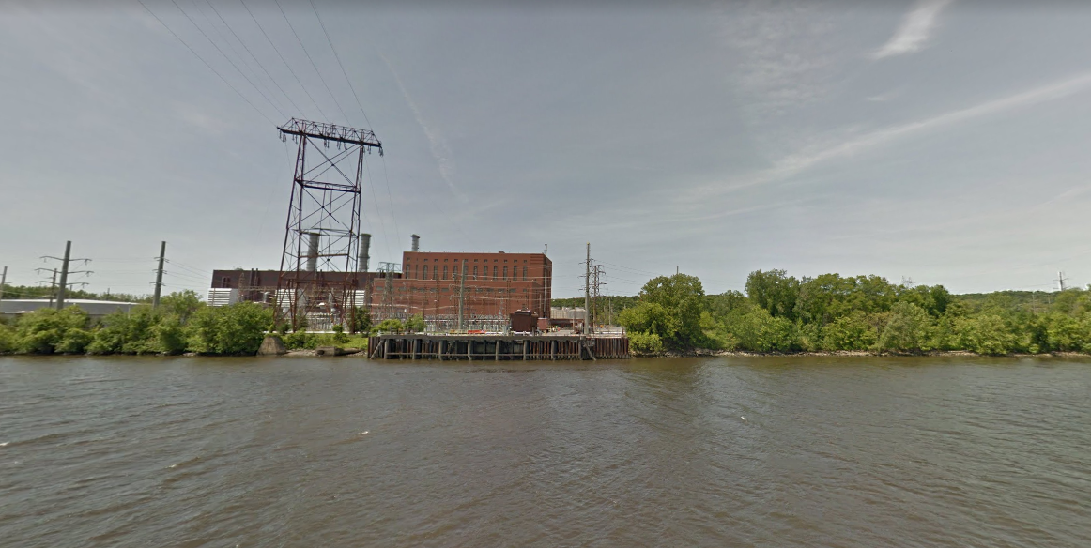
Photo – Surrounding Area
PSEG Location Immediately South of Proposed Project Site

Slide 29
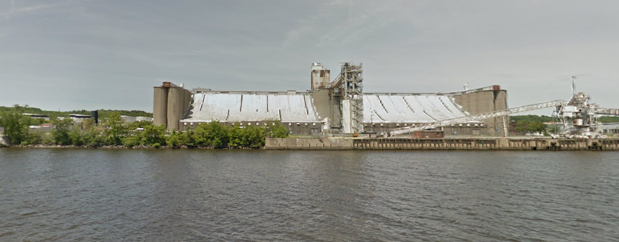
Photo – Surrounding Area
Port District Tenant Location Immediately North of Proposed Project Site

Slide 30
Photo Simulations
Video Link:
https://vimeo.com/688550723
Video on the Hudson River looking west into the site form South to North
Notes:
260+ high Tower at PSEG Plant to the south
Power transmission lines/towers
Other buildings at the Port to the North Exceed 100’ height

Slide 31
Building Height – 100’ Provided vs 60’ Code Maximum
No change in character of the neighborhood as there are 260’ tall stacks immediately to the south at the PSEG plant and multiple buildings, storage tanks and stacks in excess of 100’ immediately to the north within the existing Port District.
A heights of each building are needed because that is the minimum height required to allow for the manufacturing of the 32-feet diameter by 164-feet long tower sections. The height of the overhead cranes within the building and the building roof structure are at the minimum height required for safety, operations and building code requirements.
The variance is not substantial when considered with the surrounding properties that include structure heights up to 260’.
The SEQRA review included a detailed Visual Impact Assessment that was reviewed by the Lead Agent as well as other involved agencies during the GEIS and SEIS SEQRA processes. Approval of the SEQRA finding statement has been issued and “No Adverse Impacts” letters received from surrounding sensitive receptors.
The requirements for manufacturing the tower and transition piece section require building heights taller than 60’ due to the size of the product and production equipment.
Notes:
Town code requires 10% landscaping coverage within the Parking Lot
8.2% is provided with additional landscaping outside the “Parking Area” at the front entrance and around the detention plans, but not counted towards the requirement.
360 parking spaces are provided which is the minimum allowed for the facility.
Any additional parking lot expansion to accommodate landscaping would require further encroachment onto National Grid Property.

Slide 32
Thank You! Questions and Comments

